Slide 1
Mobile Anylsis
Unlash the power of machine learing

Slide 2
Table of contents
01
04
02
05
03
Problem Definition
Models
EDA
Scores
Data Preprocessing

Slide 3

01
Problem Definition

Slide 4

Problem Definition
Embarking on a journey of mobile comparison, we introduce a bespoke machine learning solution designed to streamline the process of classifying mobile phones into diverse price ranges. Our initiative aims to empower consumers with comprehensive insights for making well-informed purchasing decisions. Leveraging attributes such as battery power, camera quality, and memory capacity, our model employs sophisticated algorithms like Logistic Regression, Random Forest, or SVM to ensure precise classification. By meticulously preprocessing data and addressing missing values, we're poised to offer consumers accurate comparisons among mobile phones. This endeavor seeks to revolutionize the mobile shopping experience, providing consumers with the tools they need to navigate the vast array of options available to them.

Slide 5

02
EDA

Slide 6
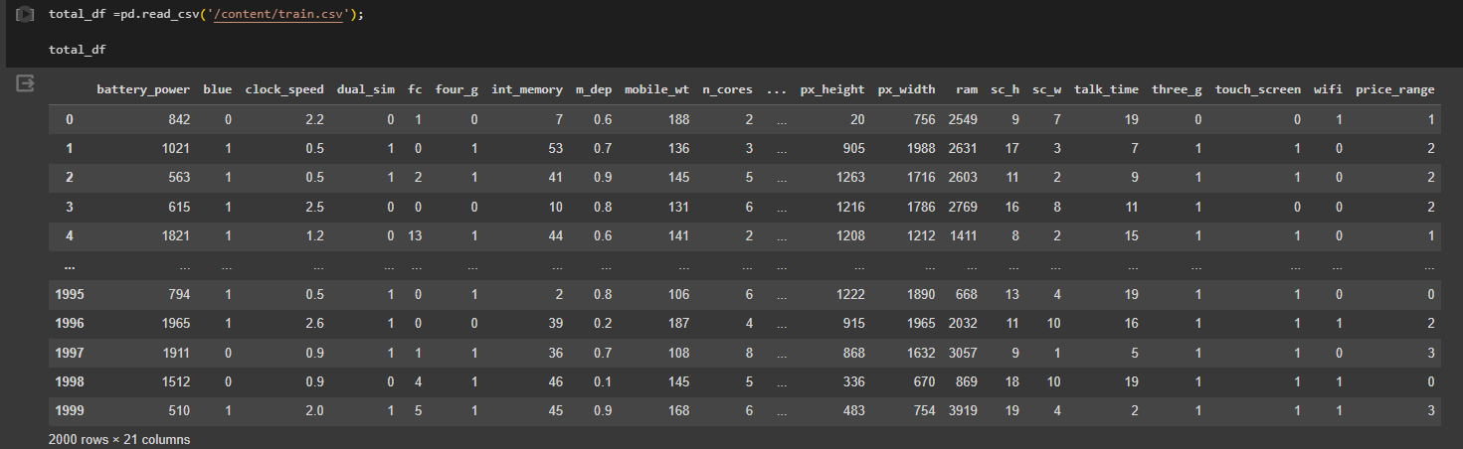
Eda
First We explore the data like knowing the feautures:
battery_power
blue
clock_speed
dual_sim
fc
four_g
int_memory
m_dep
mobile_wt
n_cores
pc
px_height
px_width
ram
sc_h
sc_w
talk_time
three_g
touch_screen
wifi
price_range

Slide 7
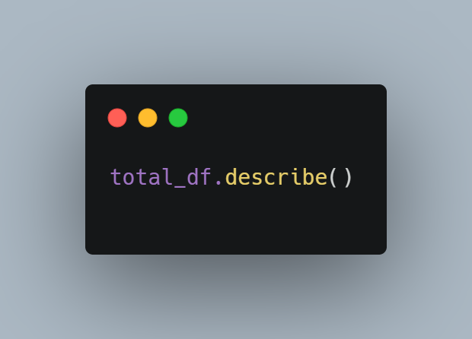
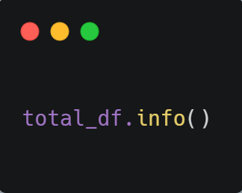
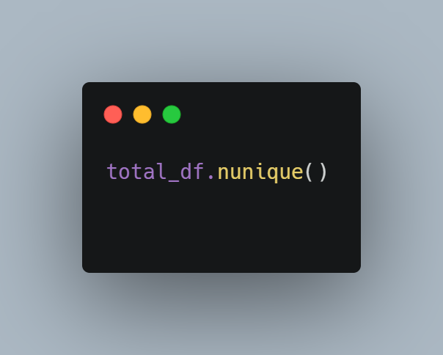
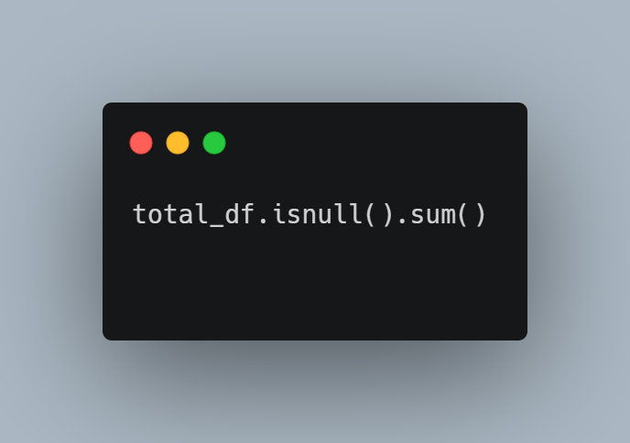
functions I used
describe
info
Nununiqe
Returns an array of nonunique values present in a column or series.
Computes the total count of missing values in each column of a dataset.
Generates descriptive statistics summarizing the central tendency, dispersion, and shape of a dataset's distribution.
Provides a concise summary of a dataset's structure, including the data types, non-null counts, and memory usage.

Slide 8
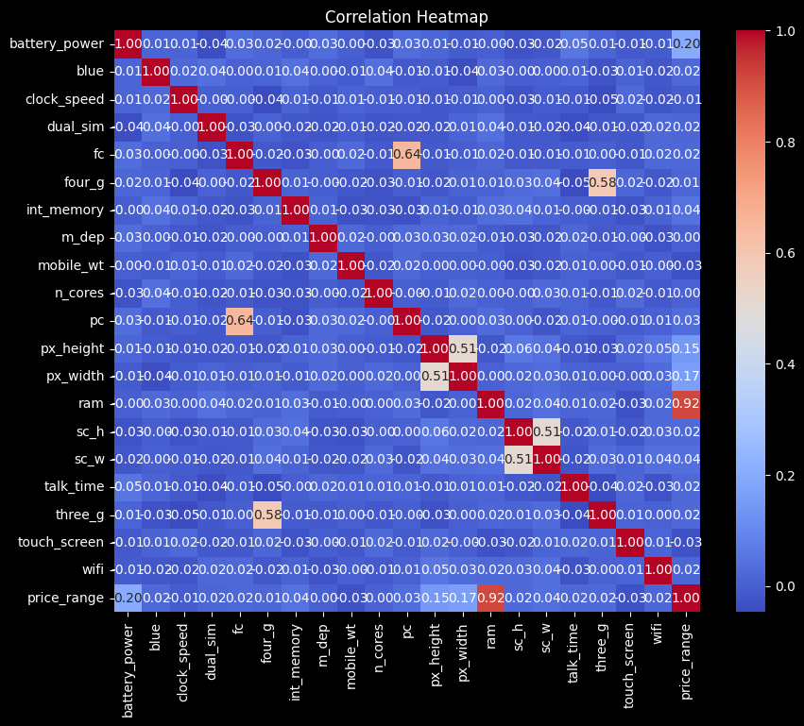
Correlation matrix
A correlation matrix is a square matrix displaying the correlation coefficients between pairs of variables in a dataset. Each cell in the matrix represents the correlation coefficient, indicating the strength and direction of the linear relationship between two variables. It is a useful tool in exploratory data analysis for identifying patterns and relationships among variables.
Here is my correlation matrix for the data

Slide 9
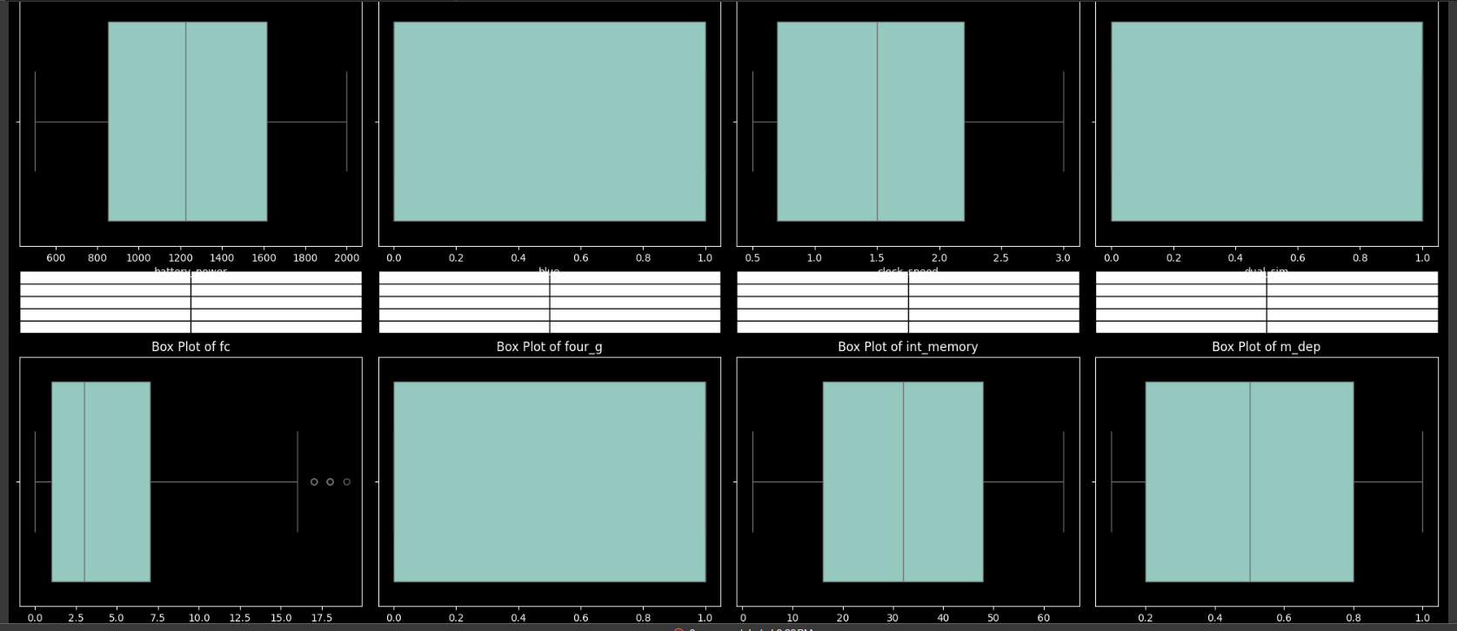
Outliers Detection
A-Boxplots
A box plot, also known as a box-and-whisker plot, visually represents the distribution of a dataset through five summary statistics: minimum, first quartile, median, third quartile, and maximum. It provides insights into the central tendency, variability, and skewness of the data, as well as potential outliers.
And here was my snapshot of some boxplots of my dataset. It showed that were no outliers or with small number.

Slide 10
03
Data Preprocessing

Slide 11
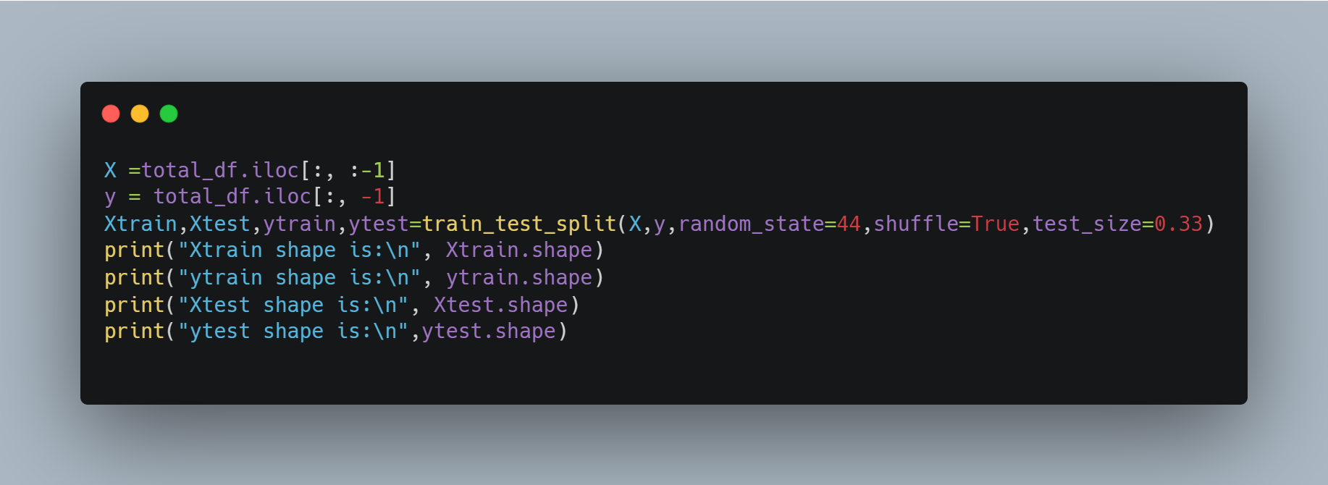
Train-Test Split
The train-test split is a technique used in machine learning to divide a dataset into two subsets: one for training the model and the other for testing its performance. Typically, a portion of the data (e.g., 70-80%) is allocated for training, while the remaining portion is reserved for testing. This allows the model to learn patterns from the training data and then evaluate its performance on unseen data to assess generalization ability and avoid overfitting

Slide 12
04
models

Slide 13
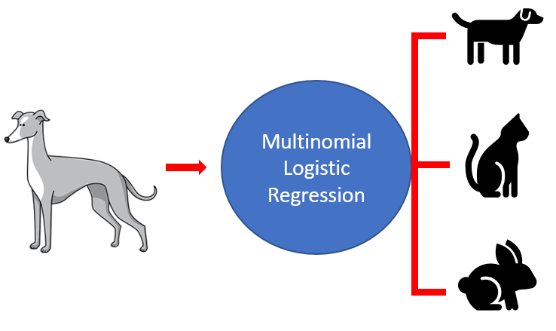
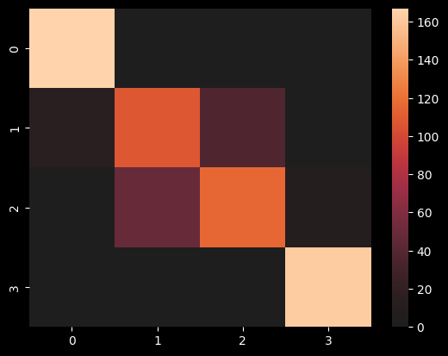
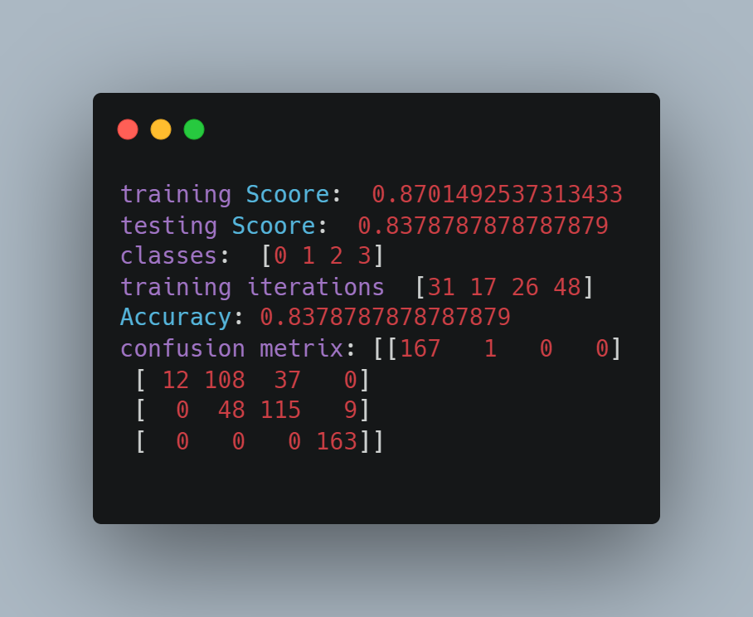
Multinomial Regression
Multinomial logistic regression extends logistic regression to predict the probabilities of multiple classes, making it suitable for multi-class classification tasks. It models the relationship between predictor variables and the categorical outcome, allowing for the estimation of probabilities across multiple categories.
Here were my result using it and scores, confusion matrix:

Slide 14
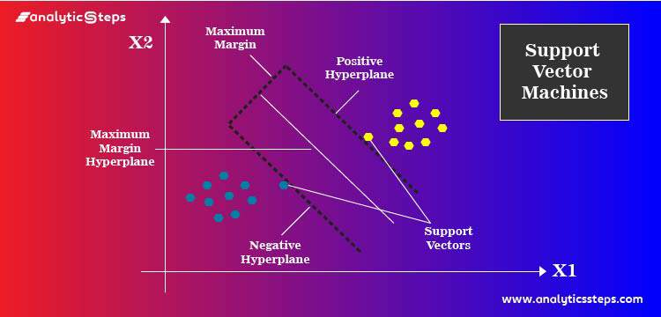
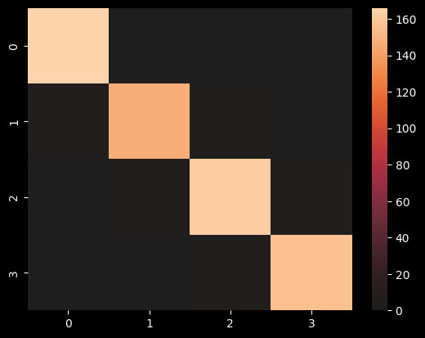
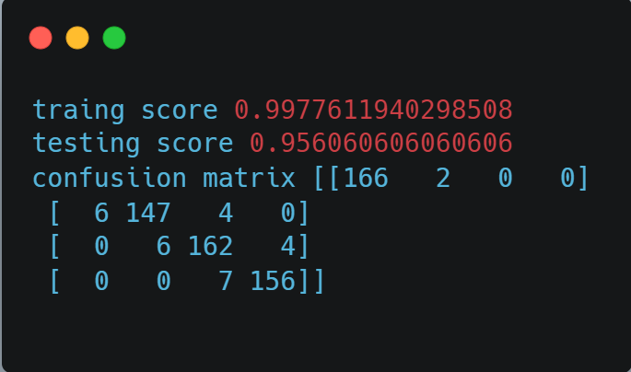
SVM Regressor
Support Vector Machine (SVM) is a powerful supervised learning algorithm used for classification and regression tasks. It works by finding the optimal hyperplane that best separates different classes in the feature space, maximizing the margin between the classes. SVM is effective for both linearly separable and non-linearly separable datasets, with various kernel functions allowing for complex decision boundaries.
Here were my result using it and scores, confusion matrix:

Slide 15
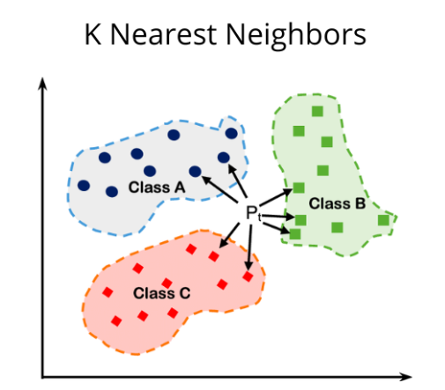
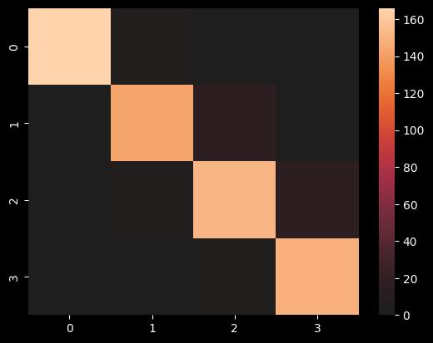
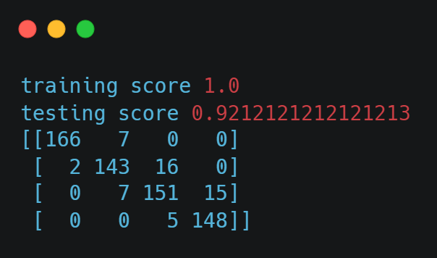
KNN
K-Nearest Neighbors (KNN) is a non-parametric algorithm used for classification and regression tasks, where predictions are made based on the majority class or average of the nearest neighbors.
By considering the proximity of data points in the feature space, KNN offers a simple yet effective method for pattern recognition and recommendation systems.
Here were my result using it and scores, confusion matrix:

Slide 16

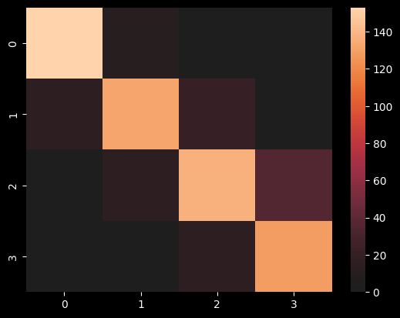
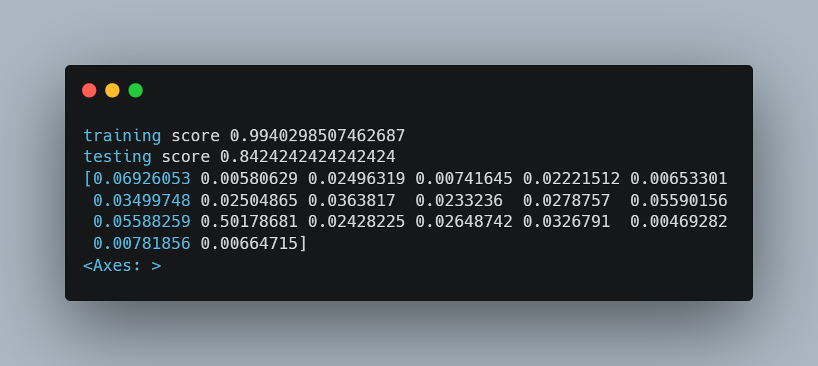
Random Forest Classifier
Random Forest Classifier, an ensemble learning technique, constructs multiple decision trees on random subsets of the data and features.
By aggregating the predictions of these trees, it enhances accuracy and reduces overfitting, making it robust for classification tasks.
Known for its scalability and effectiveness, Random Forest is widely employed across various domains in machine learning.
Here were my result using it and scores, confusion matrix:

Slide 17
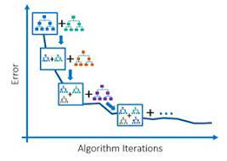
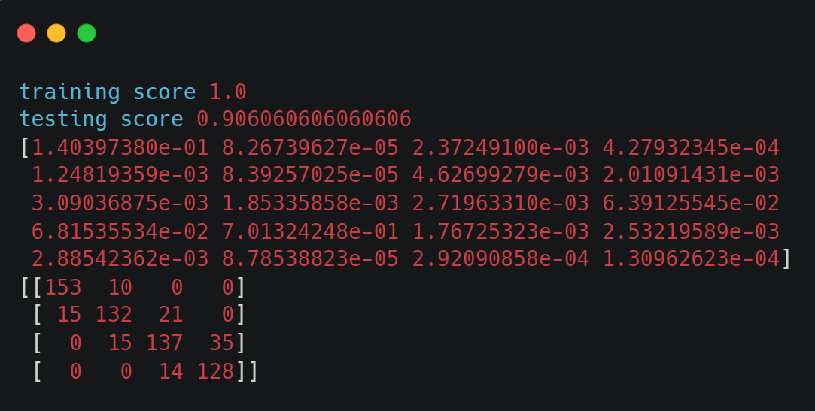
Graidient Boost Classifier
Gradient Boosting, an ensemble learning method, iteratively builds a sequence of decision trees, each minimizing the overall loss function by correcting the errors of its predecessor. By combining the strengths of individual trees, Gradient Boosting achieves high predictive accuracy and is widely used in various domains for regression and classification tasks.
Here were my result using it and scores, confusion matrix:

Slide 18
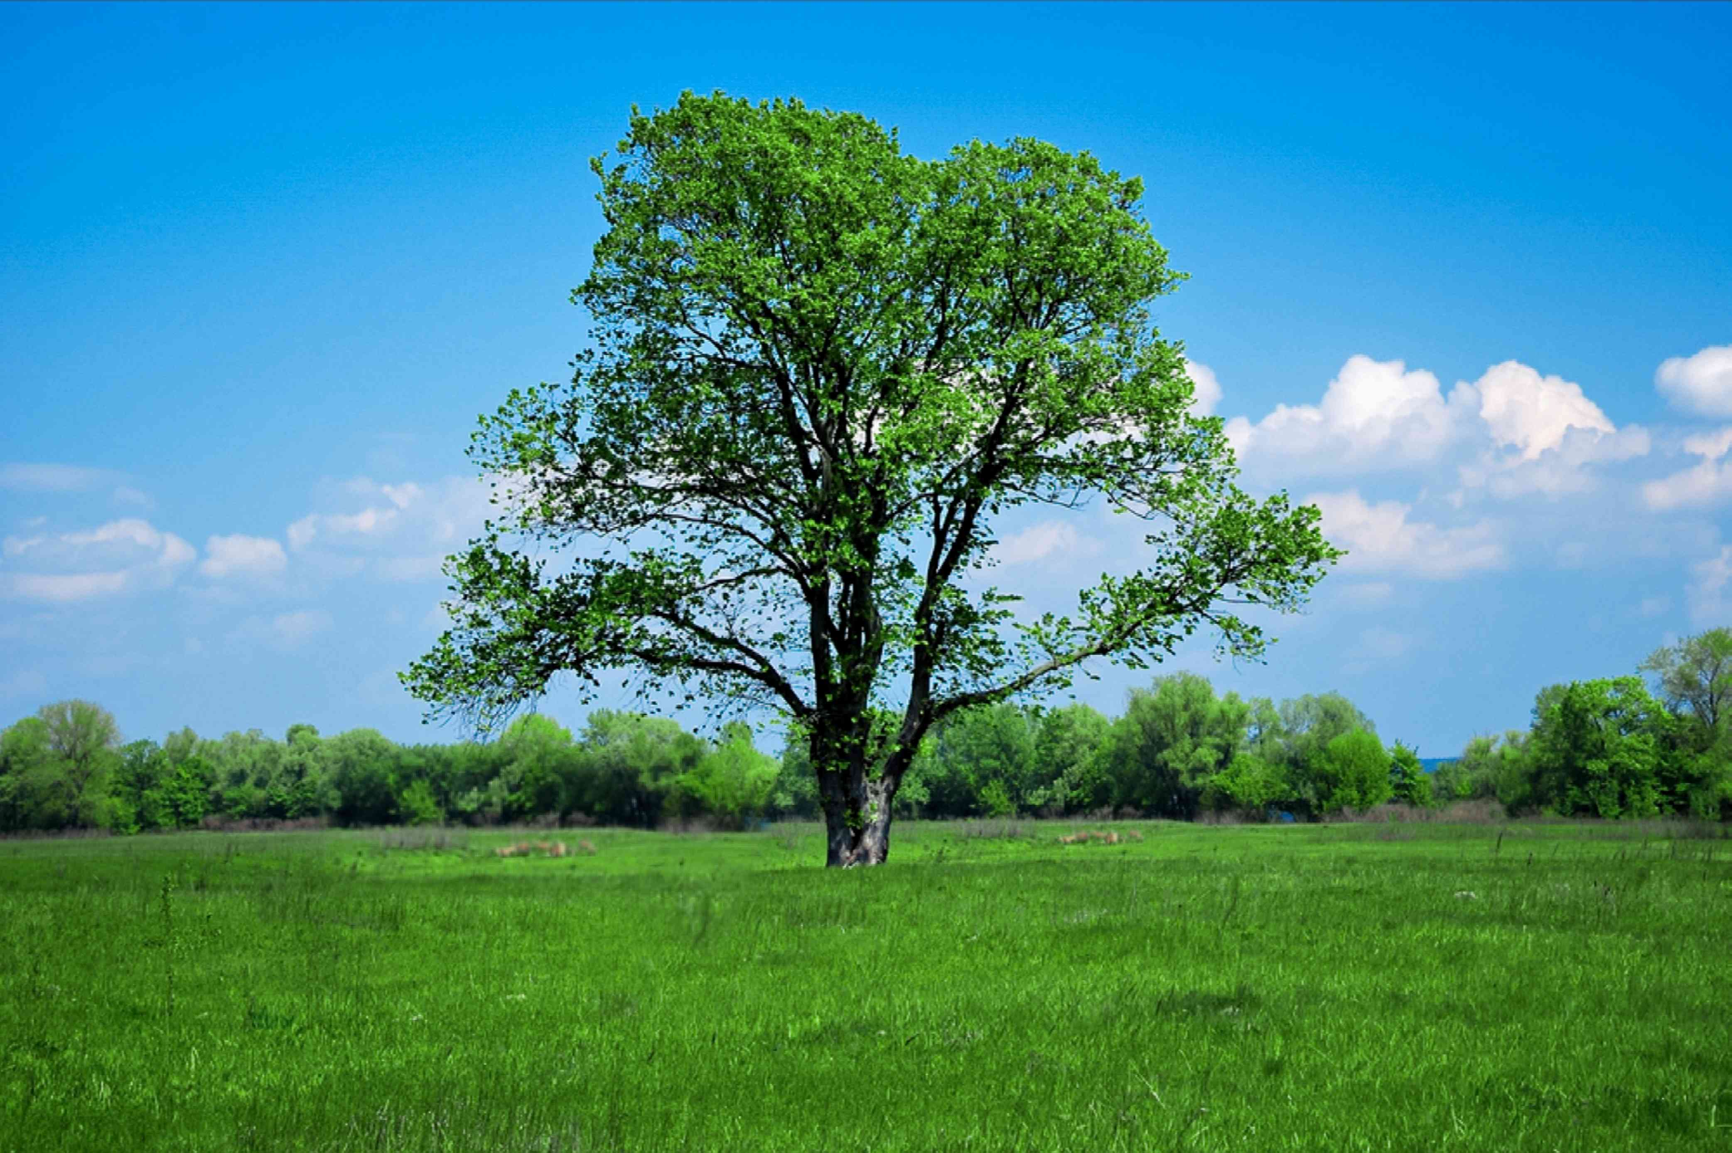
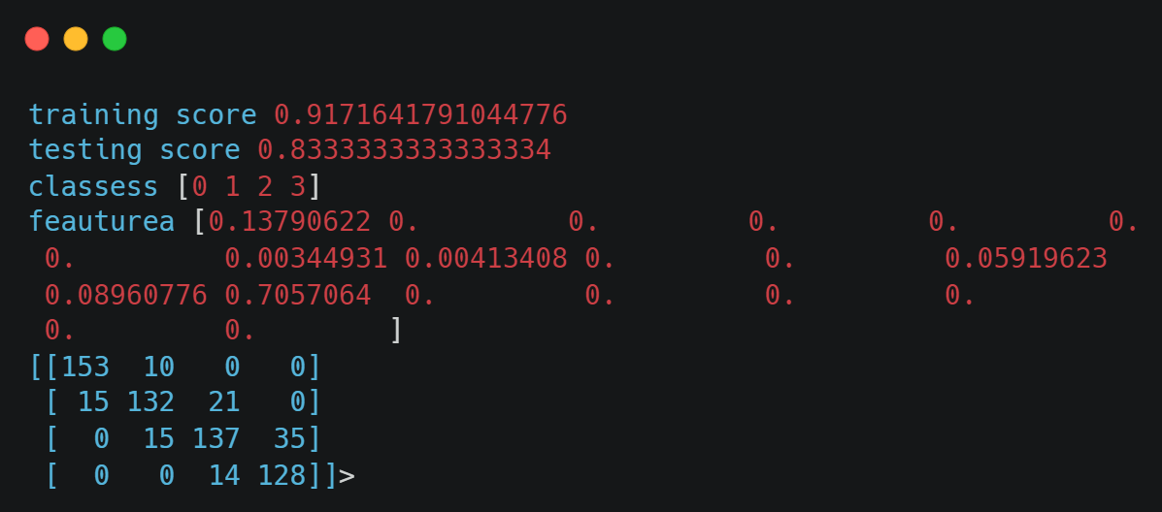
Decision Tree Classifier
Decision Tree Classifier is a versatile supervised learning algorithm used for classification tasks. It partitions the feature space into hierarchical structures of binary decisions based on the information gain or Gini impurity, enabling interpretable and efficient classification. Decision trees are capable of handling both numerical and categorical data, making them widely applicable in various domains such as finance, healthcare, and marketing.
Here were my result using it and scores, confusion matrix:

Slide 19

05
Scores

Slide 20
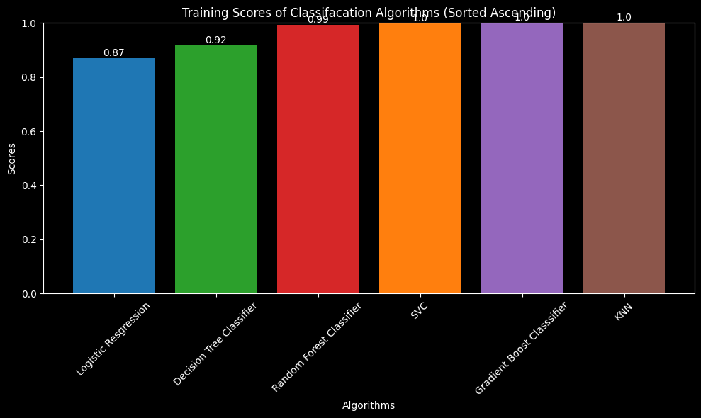
Trainiging Scores
SVC, KNN, and Gradient Boosting exhibit superior training scores, indicating their efficacy in capturing patterns within the data. Refactoring the comparison could involve visualizing the scores to highlight performance disparities and exploring optimization strategies like hyperparameter tuning for further enhancements.

Slide 21
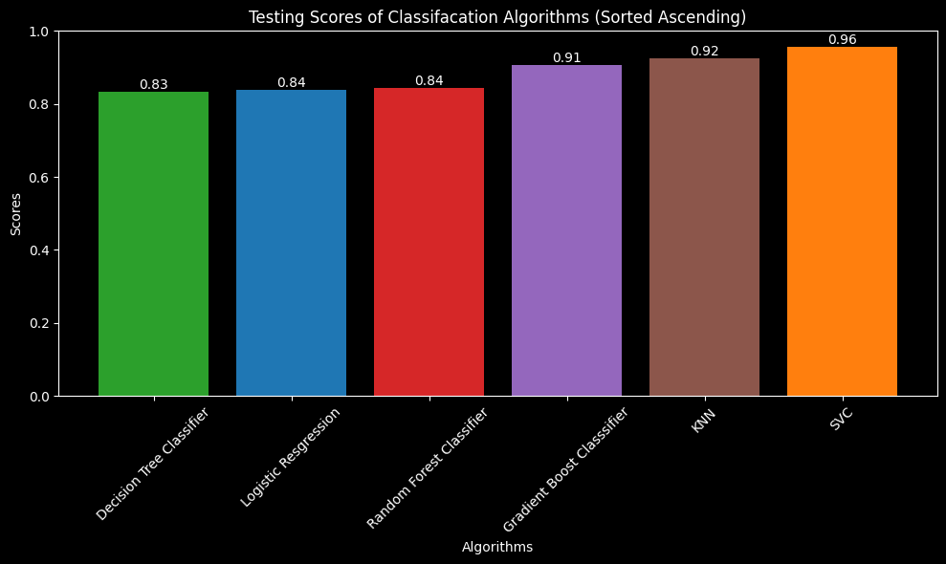
Testing Scores
For testing, SVC, KNN, and Gradient Boosting continue to demonstrate top performance based on their respective scores. Refactoring the comparison may involve visualizing these scores to elucidate model strengths and areas for improvement, such as refining hyperparameters for enhanced testing accuracy.

Slide 22
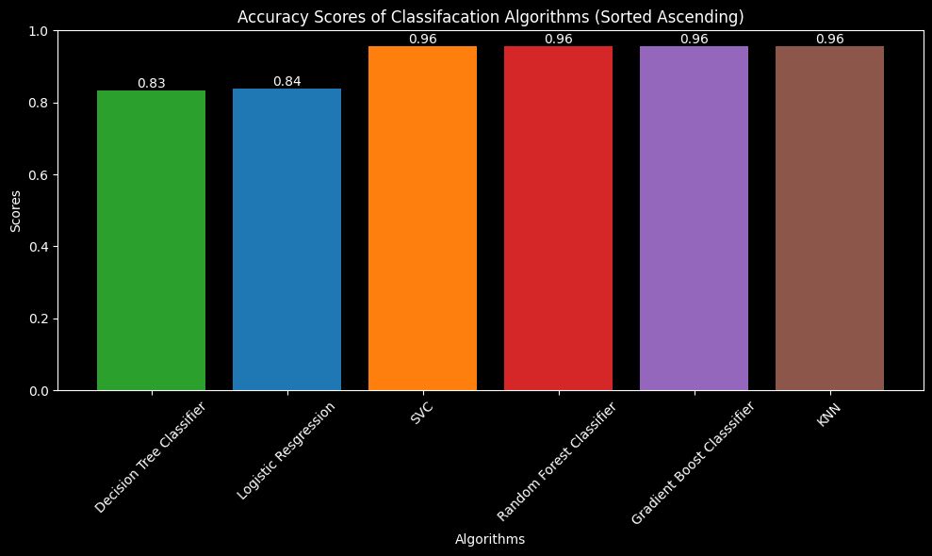
Accuracy Scores
Random Forest, KNN, and Gradient Boosting display notable accuracy scores, indicating their effectiveness in making precise predictions. Further analysis could involve exploring the specific performance metrics of each model to discern their strengths and potential areas for refinement.

